Slide 1
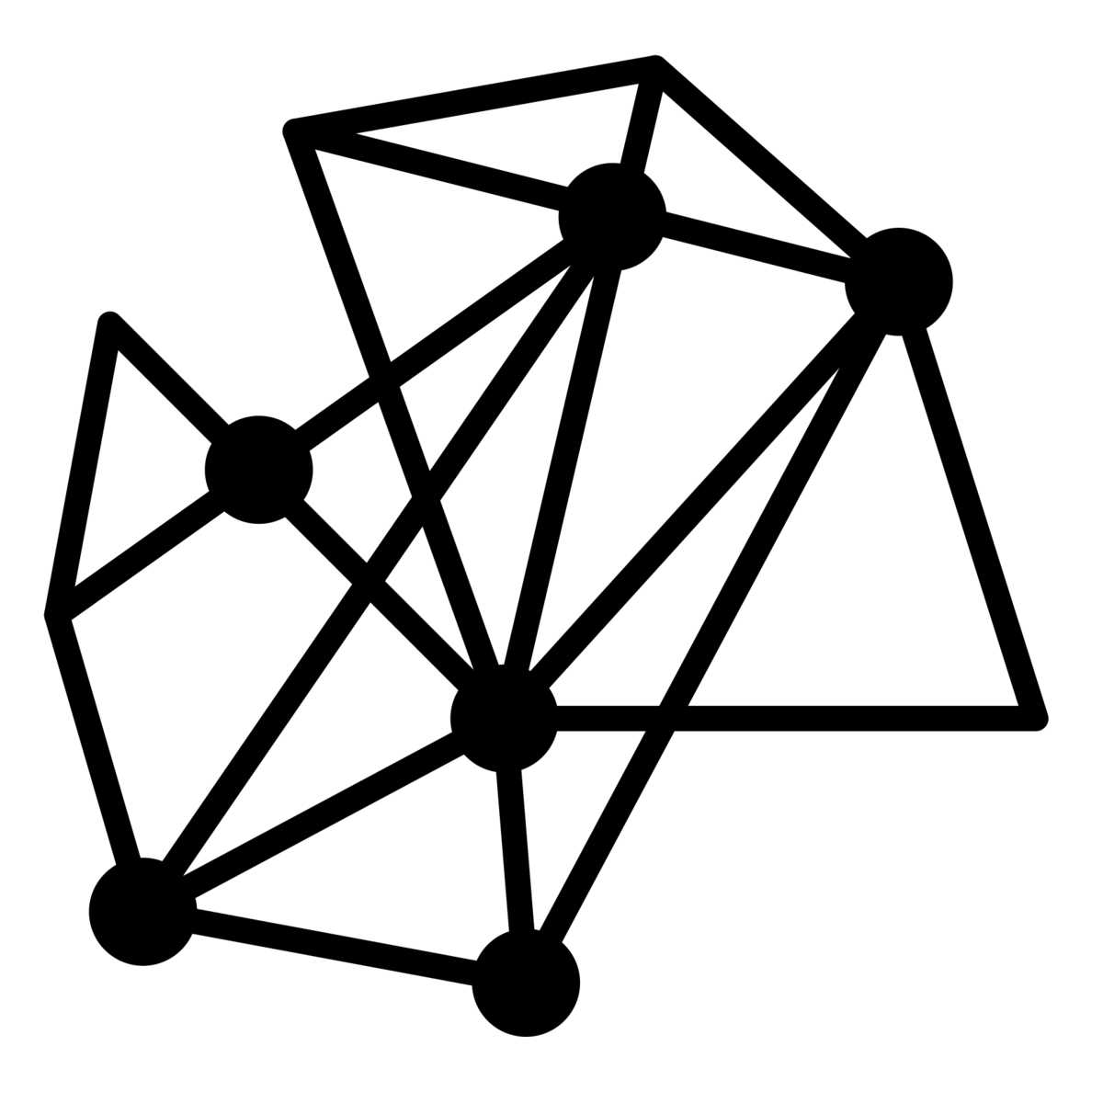
Visualizing Library Resources as Networks
Matt Miller
matthewmiller@nypl.org | @thisismmiller
NYPL Labs
New York Public Library
Code4Lib 2014, Raleigh
Notes:
About Labs
About this project
- A side investigation, very early results,

Slide 2
Agenda
Why Networks?
Networks in Archives
Networks in the Catalog
Notes:
Talk about how I am building

Slide 3
Why Networks?
Libraries and archives consist of independent documents. How do we connect them and why is it important?

Slide 4
Why Networks?
The document, then, is no longer for history an inert material through which it tries to reconstitute what individuals have done or said, the events of which only the trace remains; history is now trying to define within the documentary materials itself unities, totalities, series, relations.
-Michel Foucault
The Archaeology of Knowledge
Notes:
Domain experts cannot

Slide 5
Why Networks?
Scale
A few hundred to hundreds of thousands
See the larger patterns
Visualize collection strengths
Find outliers

Slide 6
Why Networks?
Serendipity
Interconnect lots of things and you start getting interesting relationships.
An alternative way to browse.

Slide 7
Networks in Archives
A single collection viewed as a network.
http://archives.nypl.org/mss/2993
(shout out to Trevor Thornton, @trevorthornton)

Slide 8
Networks in Archives
Explore all of the archive’s collection through a network.
http://archives.nypl.org/terms/

Slide 9
Networks in Archives
Limits of control access terms.
Most collections do not have component level access terms.
Collection level terms are not specific to find the interesting connections that we are looking for.
We need more data!
Technical limits of browser based networks.

Slide 10
Networks in Archives
Next steps
NLP the EAD files for more controlled terms.
Leverage exiting term’s linked data to bolster terms associated with a collection.
Add institutional data to the graph, who donated what.
Start building links between collections based on shared web visits.

Slide 11
Networks in the Catalog
Each subject is a node in the graph. Including subdivisions.
A subject is added only if it is used in more than one resource.
The size of the node is determined by the number of occurrences.
When two subjects occur in the same record a connection or edge is made between them.
The more co-occurrences the stronger the connection

Slide 12
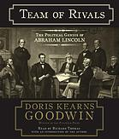
Networks in the Catalog
Lincoln, Abraham, -- 1809-1865.
Political leadership -- United States -- History.
Genius -- Case studies.
United States -- History -- Civil War, 1861-1865.
Lincoln, Abraham, -- 1809-1865 -- Friends and associates.
Presidents -- United States -- Biography.
United States -- Politics and government -- 1861-1865.

Slide 13
Networks in the Catalog
Lincoln, Abraham, -- 1809-1865.
Political leadership -- United States -- History.
Genius -- Case studies.
United States -- History -- Civil War, 1861-1865.
Lincoln, Abraham, -- 1809-1865 -- Friends and associates.
Presidents -- United States -- Biography.
United States -- Politics and government -- 1861-1865.

Slide 14
Networks in the Catalog
Lincoln, Abraham, -- 1809-1865.
Political leadership -- United States -- History.
Genius -- Case studies.
United States -- History -- Civil War, 1861-1865.
Lincoln, Abraham, -- 1809-1865 -- Friends and associates.
Presidents -- United States -- Biography.
United States -- Politics and government -- 1861-1865.

Slide 15
Networks in the Catalog
8.5+ million MARC Records
430,000+ subjects
11+ million connections

Slide 16
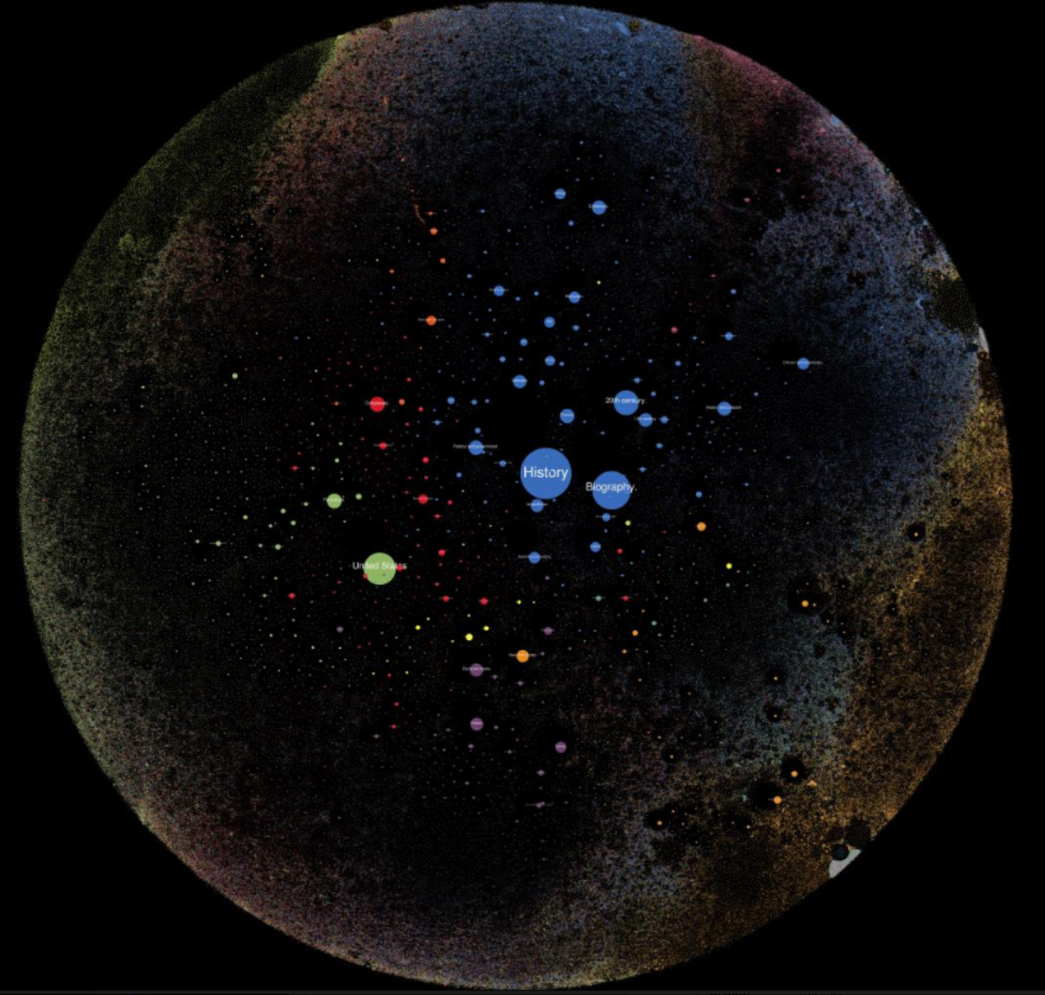
http://bit.ly/nyplnetwork

Slide 17
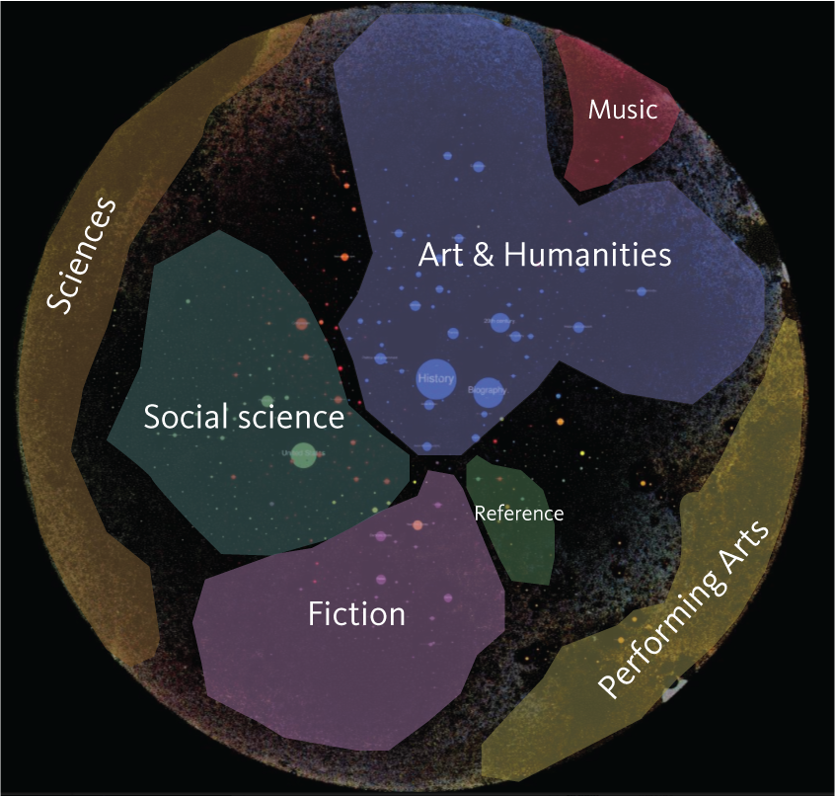

Slide 18
Networks in the Catalog
How to:
Compile MARC records into node/edge relationships.
A tool to render the network based on existing network analysis algorithms.
Take that information and make a visual representation of the network.
Present that visual representation in a web base format.

Slide 19
Networks in the Catalog
Compile MARC records into node/edge relationships.
pyMARC to process subject headings into a Gephi XML document.

Slide 20
Networks in the Catalog
A tool to render the network based on existing network analysis algorithms.
Using Gephi, but not the GUI.
Gephi Toolkit – a library of the core rendering functions of Gephi.
https://gephi.org/toolkit/
Using the Force Atlas 2 layout algorithm.
Video.

Slide 21
Networks in the Catalog
Take that information and make a visual representation of the network.
Used Python bindings of GraphicsMagick to draw one very large PNG.
Cut into tiles with libvips.
Keep track of the coordinates of all nodes.

Slide 22
Networks in the Catalog
Present that visual representation in a web base format.
Used OpenSeaDragon image tile viewer to navigate.
Used ElasticSearch to translate client clicks into node positions and provide search function.

Slide 23
Networks in the Catalog
Next Steps
Continue to refine the rendering parameters and experiment with other layout algorithms.
Use subfield subject in more specific ways.
Provide more interactivity, sub-networks, shared connections, etc.

Slide 24
Networks in the Catalog
Next Steps
Continue to refine the rendering parameters and experiment with other layout algorithms.
Use subfield subject in more specific ways.
Provide more interactivity, sub-networks, shared connections, etc.

Slide 25
Thanks!
Matt Miller
matthewmiller@nypl.org
@thisismmiller
Tools + Code
http://archives.nypl.org/terms
http://bit.ly/nyplnetwork
https://github.com/thisismattmiller/catalog-network
Icon Credits:
Network designed by Hyeji Michelle Jun from the Noun Project
Book designed by Chris Thoburn from the Noun Project
Box designed by Michael Rowe from the Noun Project
Book designed by Pedro Lalli from the Noun Project
Enlarge designed by Cornelius Danger from the Noun Project
Present designed by Naomi Atkinson from the Noun Project

