Slide 1
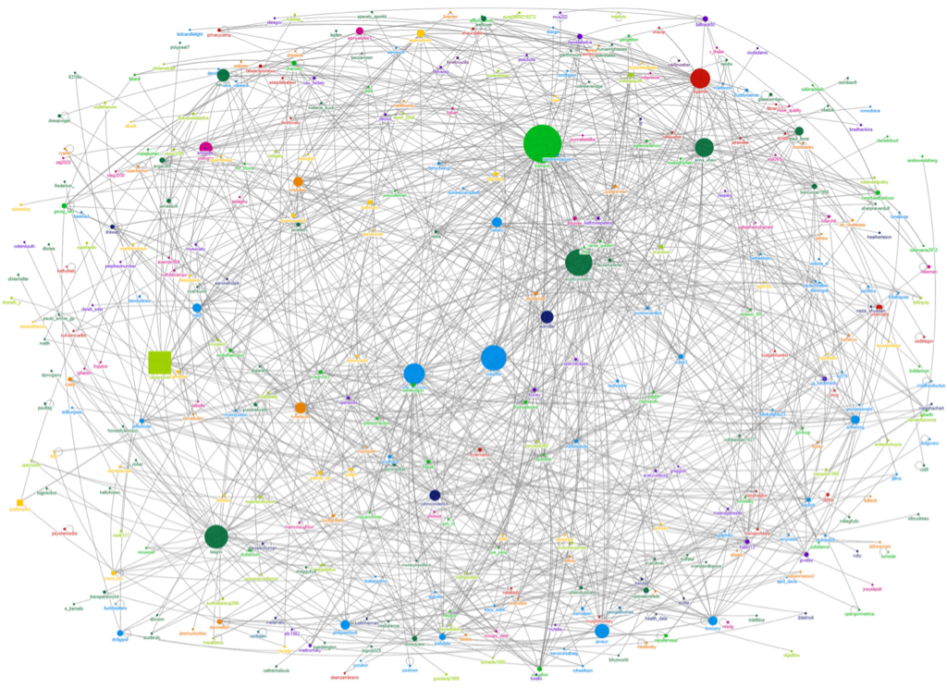
Quick & Easy Data Visualization with Google Visualization API + Google Chart Libraries
Bohyun Kim ( Twitter: @bohyunkim)
Associate Director for Library Applications & Knowledge Systems
University of Maryland, Baltimore
Health Sciences & Human Services Library
CODE4LIB Conference, Raleigh, NC. Mar. 25, 2014.

Slide 2
0. Spreadsheets Ain’t Databases.
CIRC
Newspaper holdings
Textbook lists
ACQ
Newspaper holdings
Textbook lists
REF
Newspaper holdings
Textbook lists
WEB
Newspaper holdings
Textbook lists
Notes:
Cannot run a query
Cannot display on the Web

Slide 3
Creating a web application with a database is not always a solution available, convenient, or efficient.
Image from Flickr CreativeCommons http://www.flickr.com/photos/88575173@N00/2445955296/

Slide 4
1. But What If They Were … Almost?
Data Source <-- Google Spreadsheet
Query data <-- Google Visualization API Query Language
Display on the web <-- Google Chart Libraries

Slide 5
2. Google Visualization API Query Language
Allows you to perform various data manipulations with the query to the data source, such as Google spreadsheet, fusion table, or your own database.
Enables you to query the data source and visualize data with Google Chart Libraries
Similar to SQL https://developers.google.com/chart/interactive/docs/querylanguage
Google Visualization API Reference: https://developers.google.com/chart/interactive/docs/reference

Slide 6
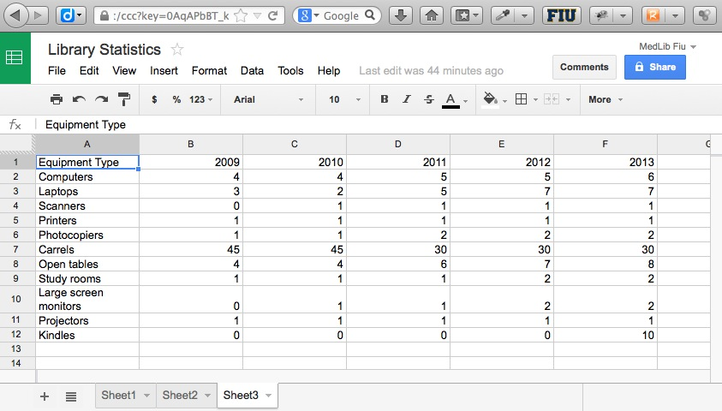
Google Spreadsheet – widely used

Slide 7
URLs for a G Spreadsheet
In Google Spreadsheet – Sheet3 https://docs.google.com/spreadsheet/ccc?key=0AqAPbBT_k2VUdDc3aC1xS2o0c2ZmaVpOQWkyY0l1eVE&usp=drive_web#gid=2
HTML Table https://spreadsheets.google.com/tq?tqx=out:html&tq=&key=0AqAPbBT_k2VUdDc3aC1xS2o0c2ZmaVpOQWkyY0l1eVE&gid=2
Raw Data Response : includes a DataTable that you can retrieve by calling getDataTable() https://spreadsheets.google.com/tq?&tq=&key=0AqAPbBT_k2VUdDc3aC1xS2o0c2ZmaVpOQWkyY0l1eVE&gid=2
google.visualization.DataTable Classhttps://developers.google.com/chart/interactive/docs/reference#DataTable
Query Language Reference (Version 0.7)https://developers.google.com/chart/interactive/docs/querylanguage#Setting_the_Query_in_the_Data_Source_URL

Slide 8
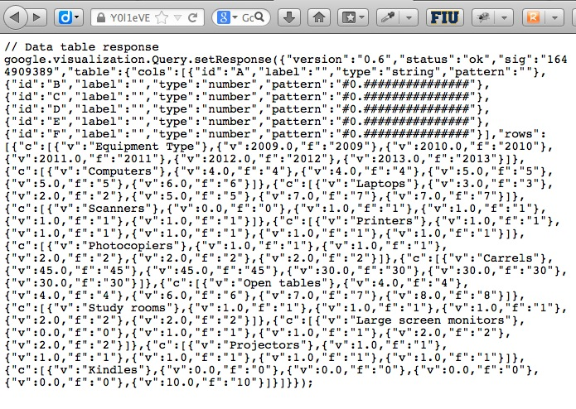
Raw Data response from G spreadsheet
https://spreadsheets.google.com/tq?&tq=&key=0AqAPbBT_k2VUdDc3aC1xS2o0c2ZmaVpOQWkyY0l1eVE&gid=2

Slide 9
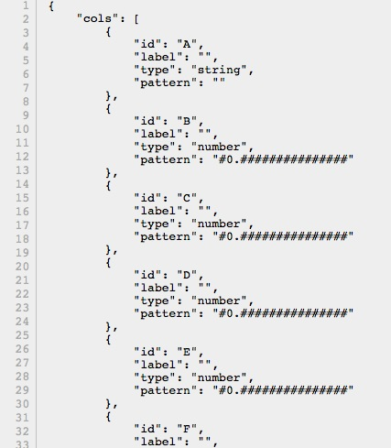
Datatable from G spreadsheet

Slide 10
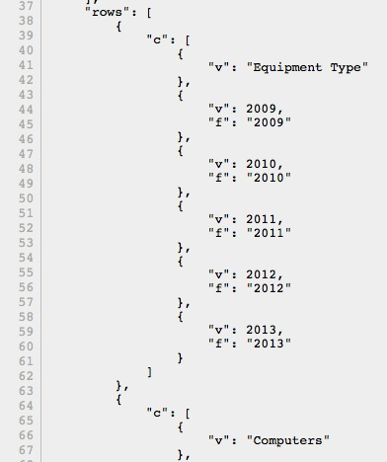

Slide 11
3-1. Query the Spreadsheet & Display the Result as a Web page
Step 1. Form a query
: Show column B, C, D, F where C contains ‘Florida’
Step 2. Output the query result
As a stand-alone web page with a table (Needed: URL)
OR Into your web page as a table / chart (Needed: JavaScript, G Chart Libraries)

Slide 12
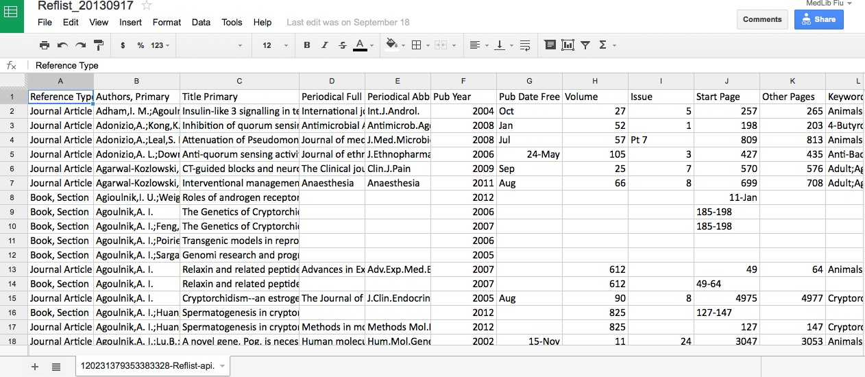
Example G Spreadsheet
https://docs.google.com/spreadsheet/ccc?key=0AqAPbBT_k2VUdDFYamtHdkFqVHZ4VXZXSVVraGxacEE&usp=drive_web#gid=0

Slide 13
What Goes into the URL
https://spreadsheets.google.com/
tq?
tqx=out:html
&tq=select B,C,D,F where (C contains 'Florida’)
&key=0AqAPbBT_k2VUdEtXYXdLdjM0TXY1YUVhMk9jeUQ0NkE
&gid=0 (optional for Sheet1)

Slide 14
Result of the query: SELECT B, C, D, F WHERE C CONTAINS ‘Florida’
https://spreadsheets.google.com/tq?tqx=out:html&tq=select+B,C,D,F+where+%28C+contains+%27Florida%27%29&key=0AqAPbBT_k2VUdEtXYXdLdjM0TXY1YUVhMk9jeUQ0NkE
N.B. Google Spreadsheet Size Limit: 400k cells, 256 columns, 20 MB
https://support.google.com/drive/answer/2505921?hl=en

Slide 15
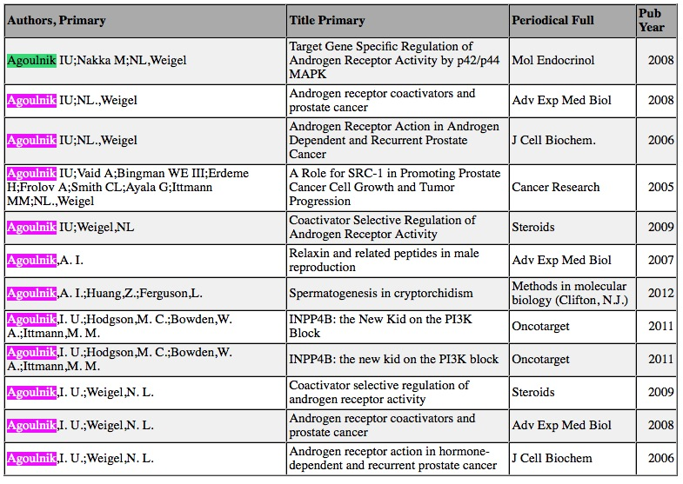
https://spreadsheets.google.com/tq?tqx=out:html&tq=select+B,C,D,F+where+%28B+contains+%27Agoulnik%27%29&key=0AqAPbBT_k2VUdEtXYXdLdjM0TXY1YUVhMk9jeUQ0NkE

Slide 16
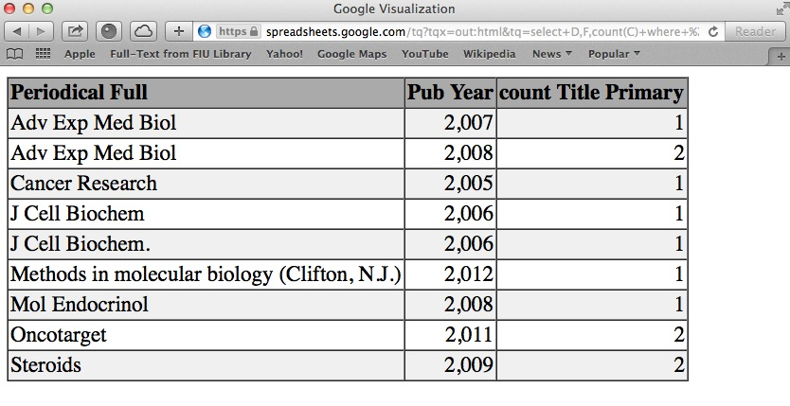
SELECT D,F COUNT(C) WHERE (B CONTAINS ‘Agoulnik’) GROUP BY D, F
https://spreadsheets.google.com/tq?tqx=out:html&tq=select+D,F,count(C)+where+%28B+contains+%27Agoulnik%27%29+group+by+D,F&key=0AqAPbBT_k2VUdEtXYXdLdjM0TXY1YUVhMk9jeUQ0NkE

Slide 17
Query Options
Order by, Limit, Offset, Group By (), Pivot
Label, Format
avg(), max(), min()
count(), sum()
year(), month(), date(), hour()
minute(), second(), millisecond()
quarter(), dayOfWeek(), now(), dateDiff()
toDate(), upper(), lower()
https://developers.google.com/chart/interactive/docs/querylanguage#Options

Slide 18
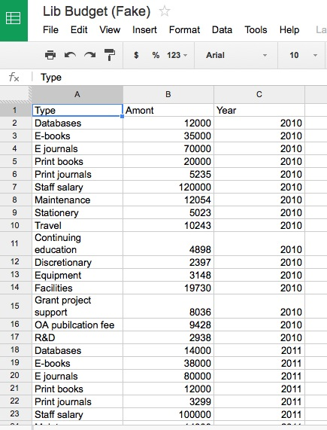
PIVOT

Slide 19
select sum(B) pivot C
https://spreadsheets.google.com/tq?tqx=out:html&tq=select%20sum%28B%29%20pivot%28C%29&key=0AqAPbBT_k2VUdHg4X08zMXFMeXRmdURJNUx5blpYUmc

Slide 20
select c, sum(B) group by (C)
https://spreadsheets.google.com/tq?tqx=out:html&tq=select%20C,sum%28B%29%20group%20by%28C%29&key=0AqAPbBT_k2VUdHg4X08zMXFMeXRmdURJNUx5blpYUmc&gid=0

Slide 21
select A, sum(B) group by A pivot C
https://spreadsheets.google.com/tq?tqx=out:html&tq=select%20A,%20sum%28B%29%20group%20by%20A%20pivot%20C&key=0AqAPbBT_k2VUdHg4X08zMXFMeXRmdURJNUx5blpYUmc&gid=0

Slide 22
select C, sum(B) group by C pivot A
https://spreadsheets.google.com/tq?tqx=out:html&tq=select%20C,%20sum%28B%29%20group%20by%20C%20pivot%20A&key=0AqAPbBT_k2VUdHg4X08zMXFMeXRmdURJNUx5blpYUmc&gid=0

Slide 23
3-2. Use JS instead of a URL
More flexible and you can add control options for users.
To set the query string from within JavaScript code, call the setQuery method of the google.visualization.Query class.

Slide 24
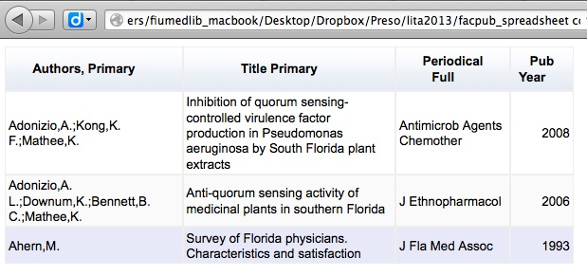
Drop It into Your Own Web Page
Query: SELECT B, C, D, F WHERE C contains ‘Florida’

Slide 25
Parameters
headers=N - Specifies how many rows are header rows, where N is an integer zero or greater. These will be excluded from the data and assigned as column labels in the data table. If not specified, the spreadsheet will guess how many rows are header rows.
Range=NN:NN Example: range=A1:C6
gid=N - Specifies which sheet in a multi-sheet document to link to, if you are not linking to the first sheet. N is the sheet's ID number. Example: gid=0 (for Sheet1)
sheet=sheet_name - Specifies which sheet in a multi-sheet document you are linking to, if you are not linking to the first sheet. sheet_name is the display name of the sheet. You can use the gid parameter instead of this parameter. Example: sheet=Sheet5

Slide 26
4. Visualize Your G Spreadsheet Data Using Google Chart Libraries
The most common way to use Google Charts is with simple JavaScript that you embed in your web page.
You load some Google Chart libraries.
List the data to be charted.
Select options to customize your chart.
Create a chart object with an id that you choose.
Then, later in the web page, you create a <div> with that id to display the Google Chart.
https://developers.google.com/chart/interactive/docs/

Slide 27
Visualize as a table or a chart
To set the query string from within JavaScript code, call the setQuery method of the google.visualization.Query class.
3 chart drawing techniques:
chart.draw()
ChartWrapper
DrawChart()
See also: https://developers.google.com/chart/interactive/docs/drawing_charts

Slide 28
(a) chart.draw()
Process
Load the JSAPI, Google Visualization, and chart libraries.
Prepare your data.
Prepare any chart options.
Instantiate the chart class, passing in a handle to the page container element.
Optionally register to receive any chart events. If you intend to call methods on the chart, you should listen for the "ready" event.
Call chart.draw(), passing in the data and options.
Advantages
You have complete control over every step of the process.
You can register to listen for all events thrown by the chart.
Disadvantages
Verbose
You must explicitly load all required chart libraries
If you send queries, you must manually implement for the callback, check for success, extract the returned DataTable, and pass it to the chart.

Slide 29
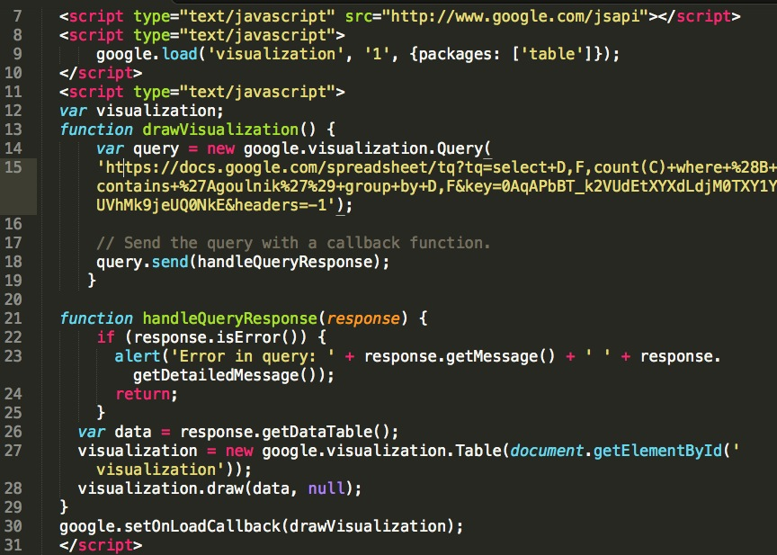
example1._florida.html

Slide 31
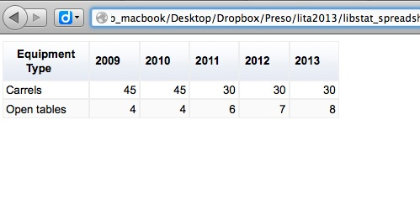
Separate the Query from URL

Slide 32
Multiple charts

Slide 33
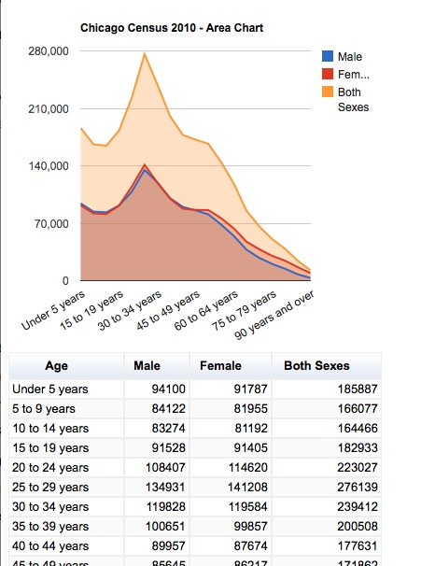
example2_chartdraw.html
Adapted from: Traci L. Ruthkoski, Google Visualization API Essentials, Packt, 2013.

Slide 34
(b) chartwrapper
ChartWrapper is a convenience class that handles loading all the appropriate chart libraries for you and also simplifies sending queries to Chart Tools Datasources.
Advantages:
Much less code
Loads all the required chart libraries for you
Makes querying data sources much easier by creating the Query object and handling the callback for you
Pass in the container element ID, and it will call getElementByID for you.
Data can be submitted in a variety of formats: as an array of values, as a JSON literal string, or as a DataTable handle
Disadvantages:
ChartWrapper currently propagates only the select, ready, and error events. To get other events, you must get a handle to the wrapped chart and subscribe to events there. See the ChartWrapper documentation for examples.

Slide 35
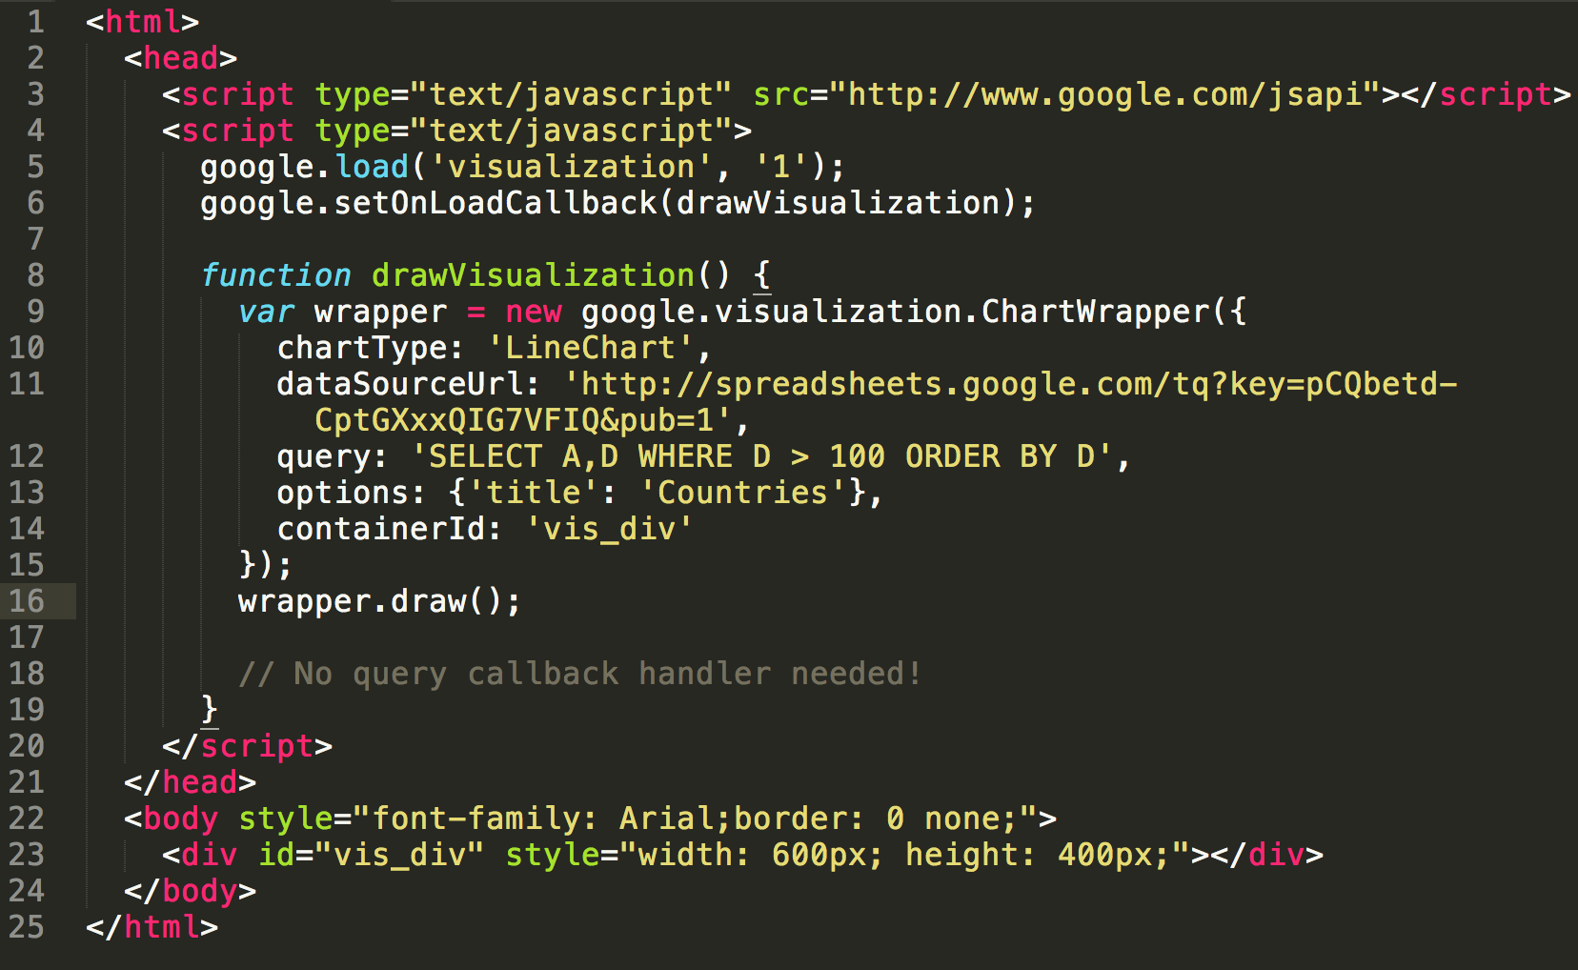
https://developers.google.com/chart/interactive/docs/drawing_charts#chartwrapper

Slide 36
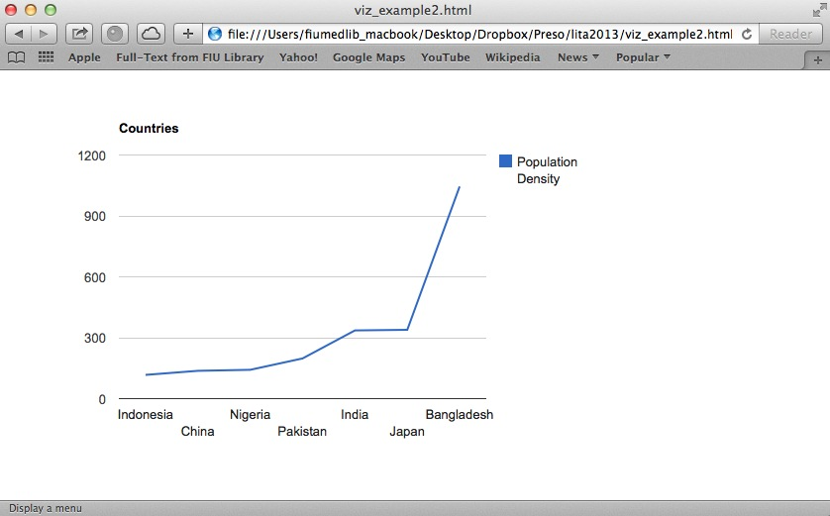
Line chart - query: 'SELECT A,D WHERE D > 100 ORDER BY D',
https://developers.google.com/chart/interactive/docs/drawing_charts#chartwrapper

Slide 37
(c) Drawchart()
DrawChart() is a global static method that wraps a ChartWrapper.
Advantages:
Same as ChartWrapper, but slightly shorter to use.
Disadvantages:
Does not return a handle to the wrapper, so you cannot handle any events.

Slide 38
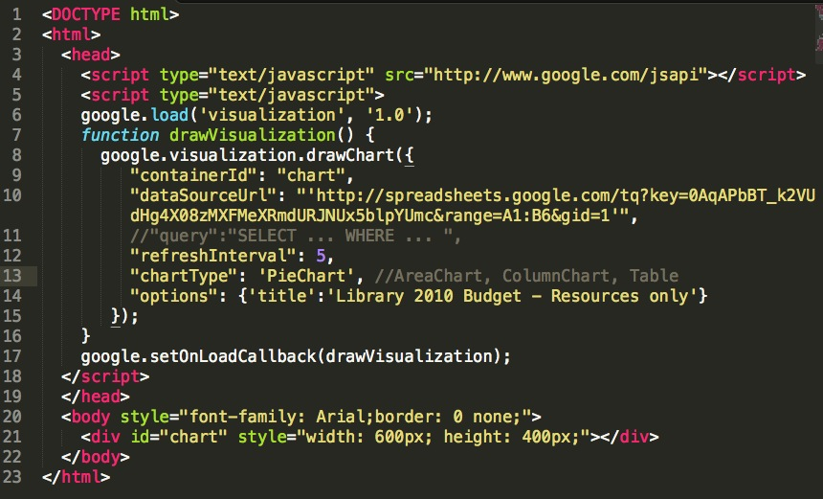
example3_piechart.html

Slide 39
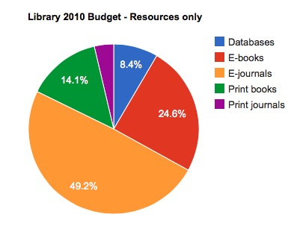

Slide 40
5. Use Data from Your Own Database with Google Chart Libraries

Slide 41
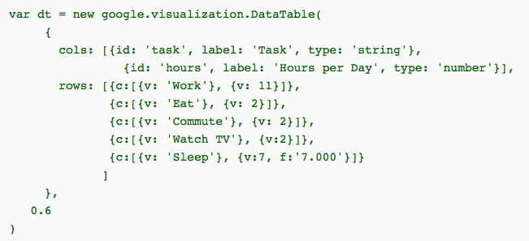
Simple G DataTable
https://developers.google.com/chart/interactive/docs/reference#DataTable

Slide 42
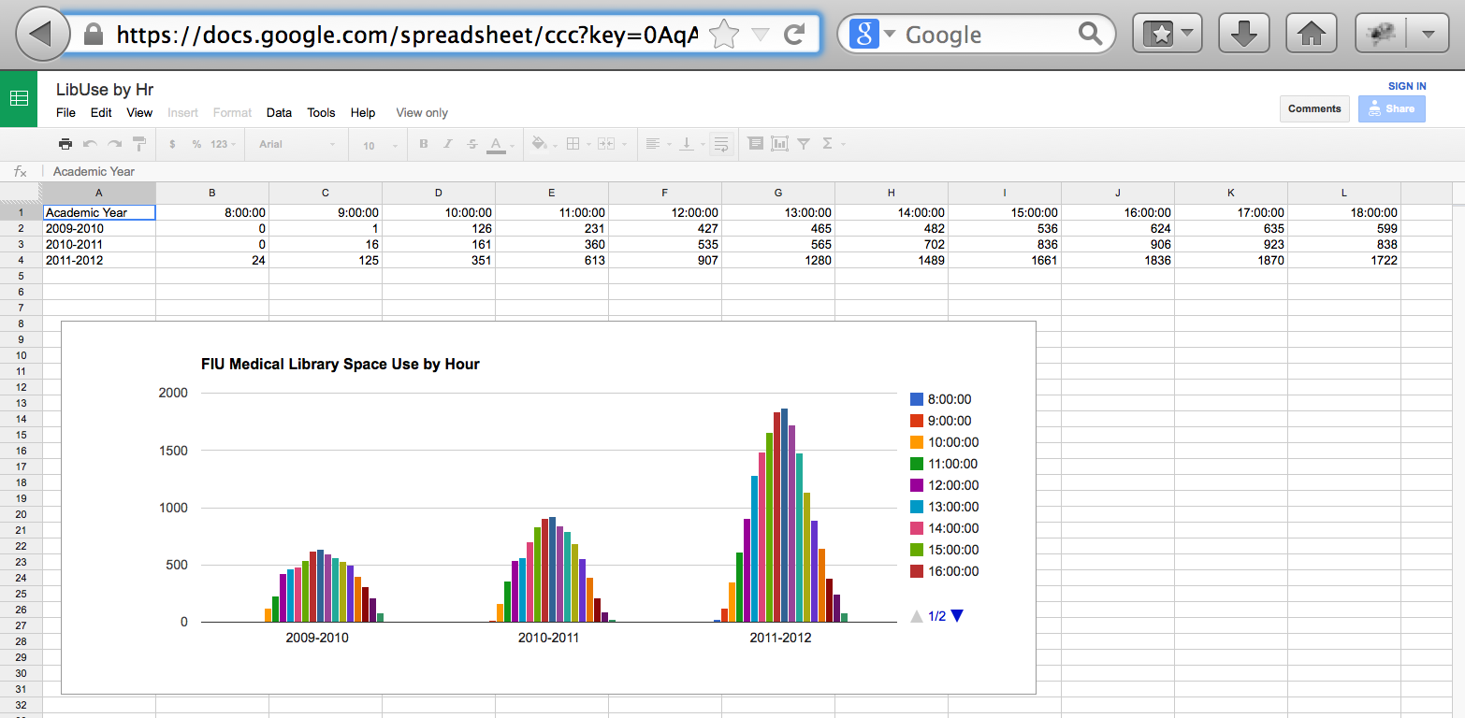
G Spreadsheet

Slide 43
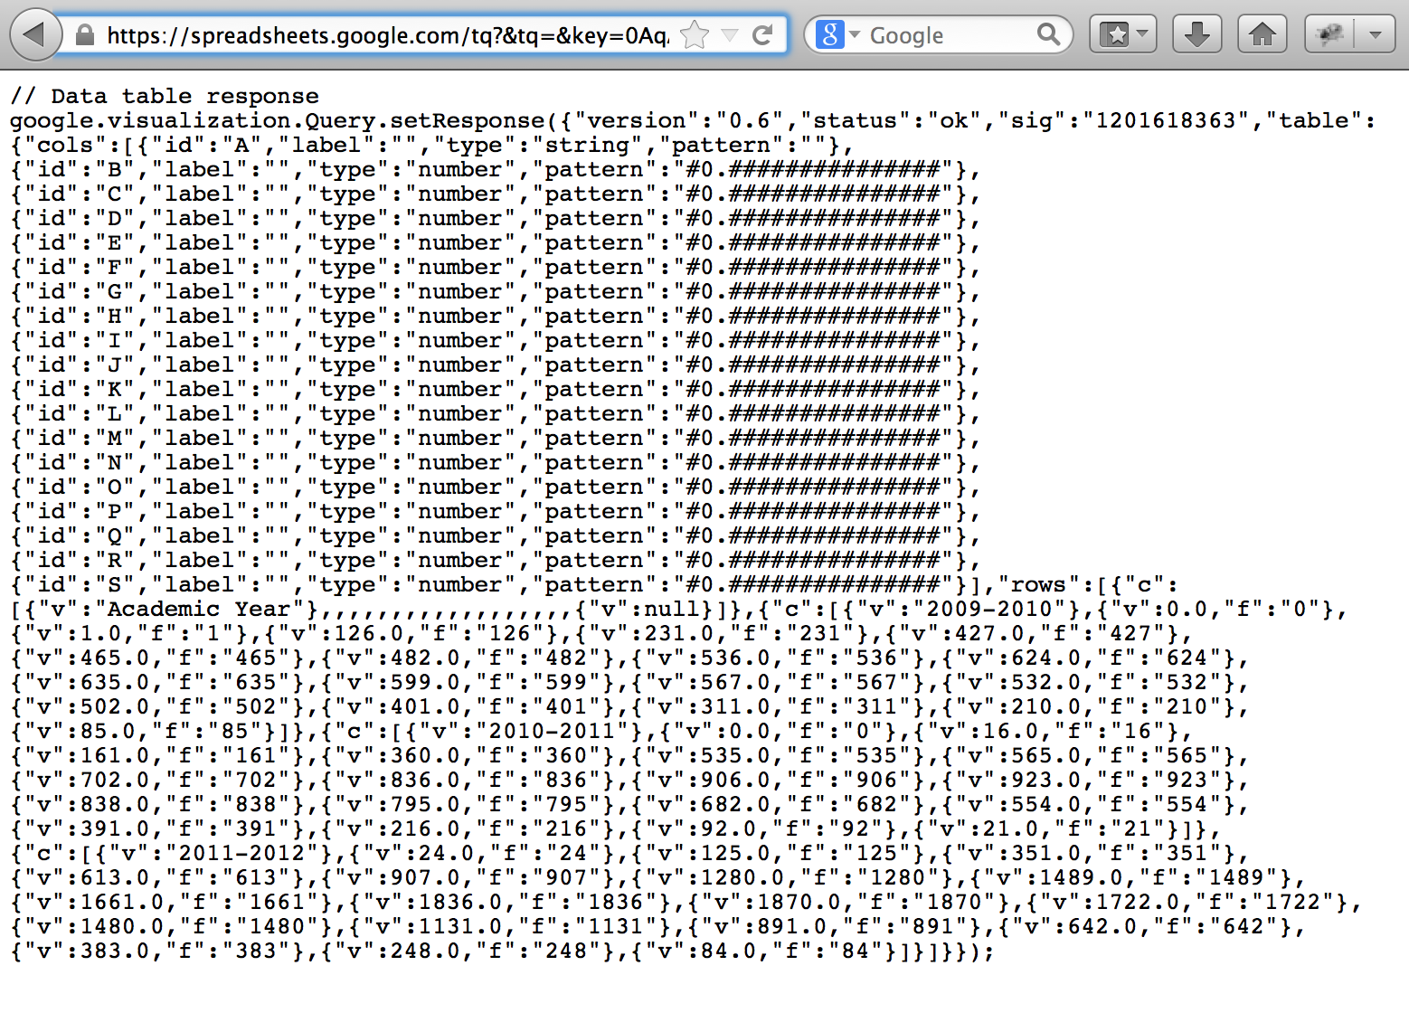
Datatable response
https://spreadsheets.google.com/tq?&tq=&key=0AqAPbBT_k2VUdFgwUm5oeHNEajlhODJoR2pVVWlTeFE&gid=0

Slide 44
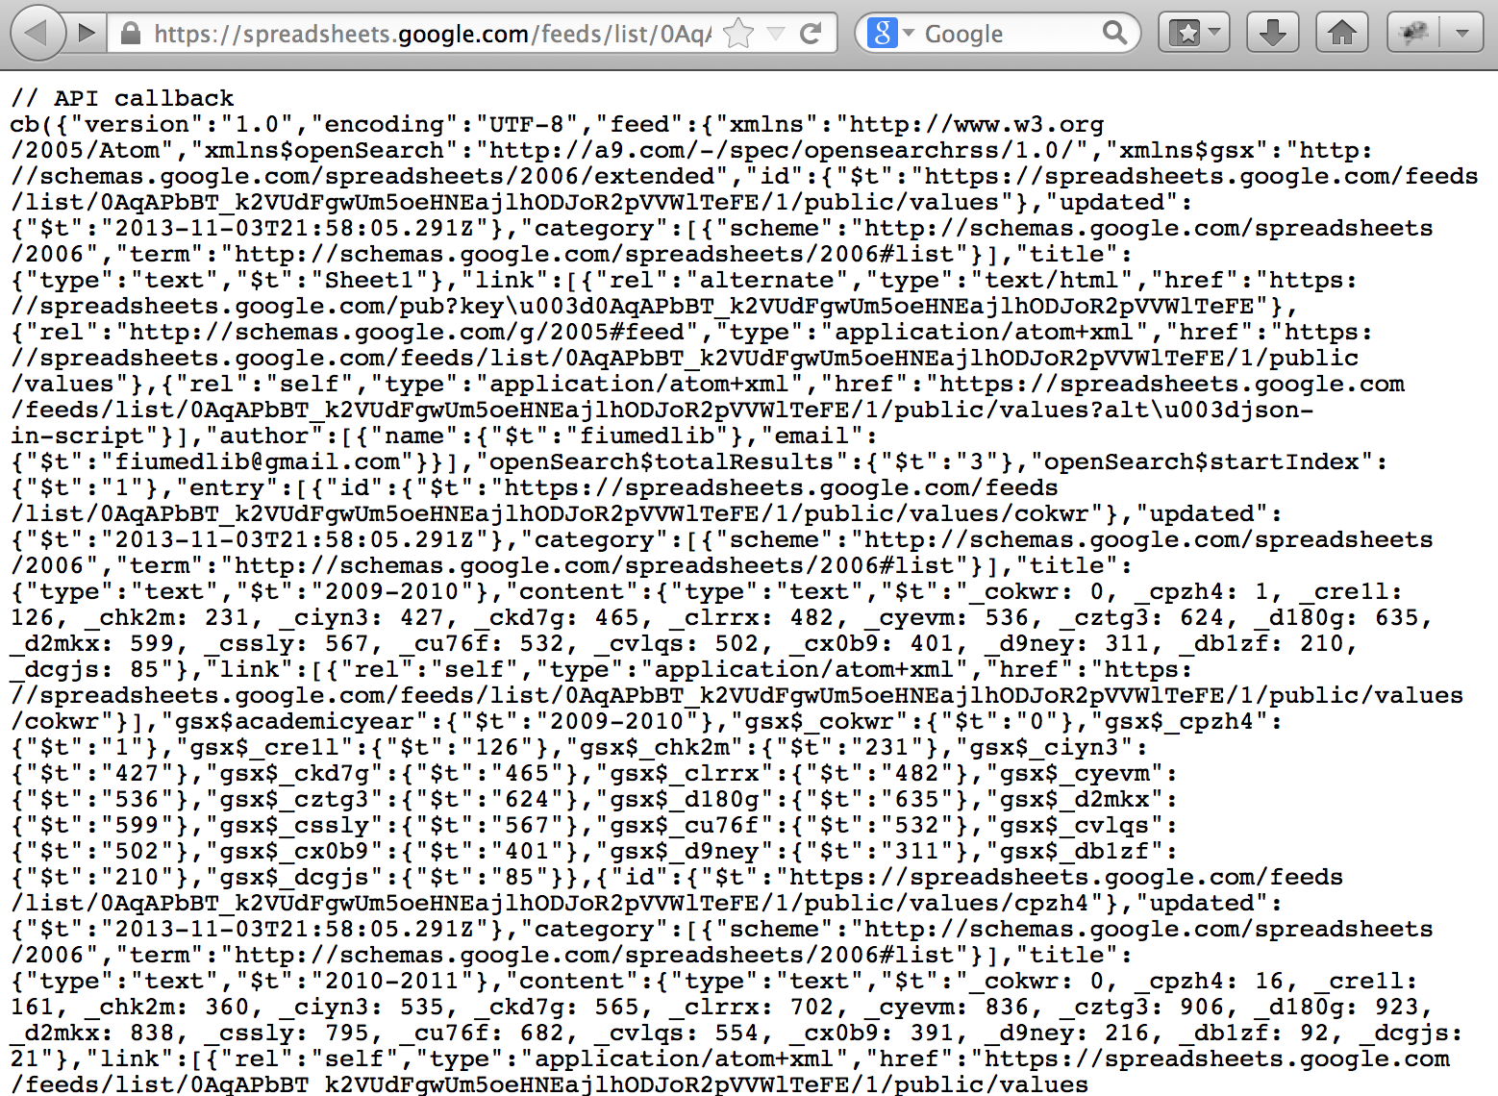
JSON Feed from G Spreadsheet
https://spreadsheets.google.com/feeds/list/0AqAPbBT_k2VUdFgwUm5oeHNEajlhODJoR2pVVWlTeFE/1/public/values?alt=json-in-script&callback=cb

Slide 45
An Example MySQL db table
Source for the PHP script on the next slide:
http://stackoverflow.com/questions/12994282/php-mysql-google-chart-json-complete-example

Slide 46
Construct G DataTable from MySQL db
{ "cols":[{"label":"Weekly Task","type":"string"},{"label":"Percentage","type":"number"}], "rows":[{"c":[{"v":"Sleep"},{"v":30}]},{"c":[{"v":"Watching Movie"},{"v":10}]},{"c":[{"v":"Job"},{"v":40}]},{"c":[{"v":"Exercise"},{"v":20}]}]
}

Slide 47
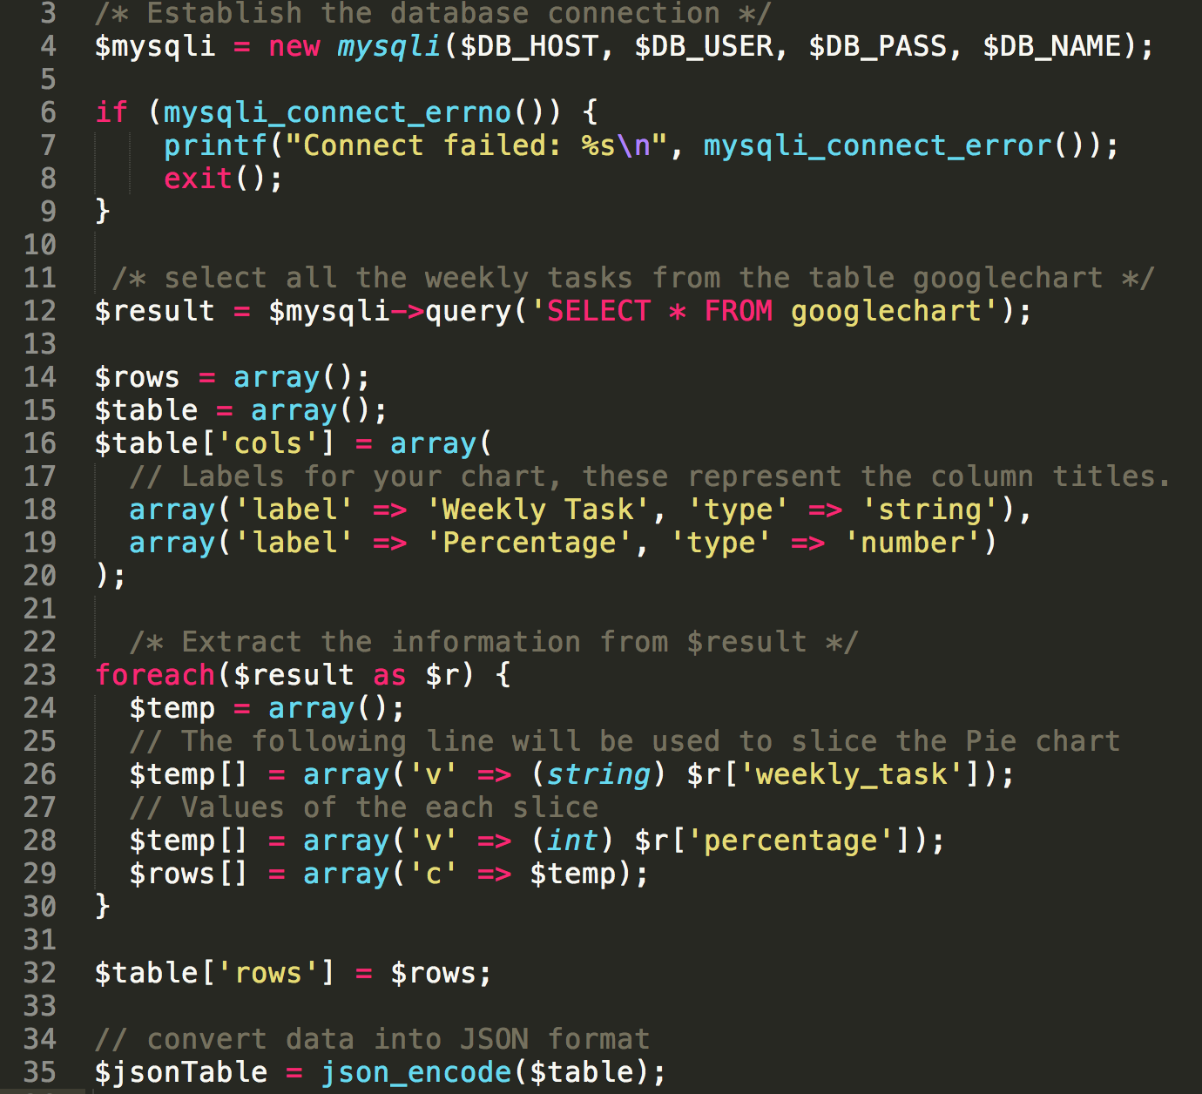

Slide 48
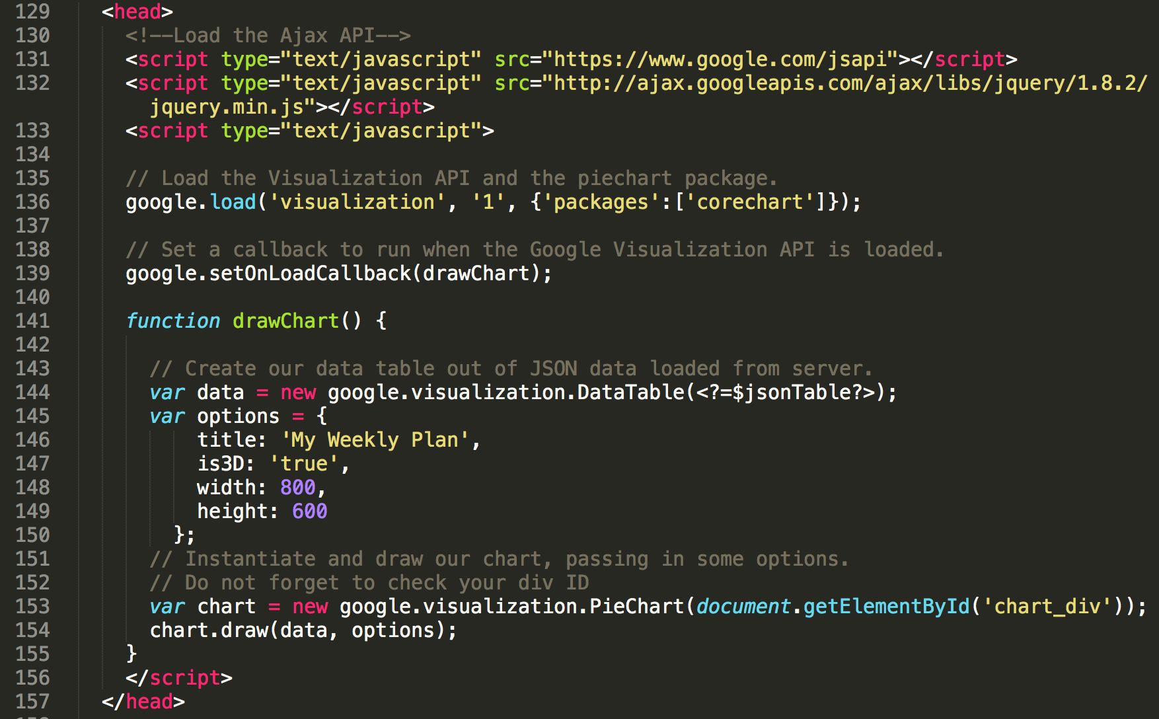

Slide 49
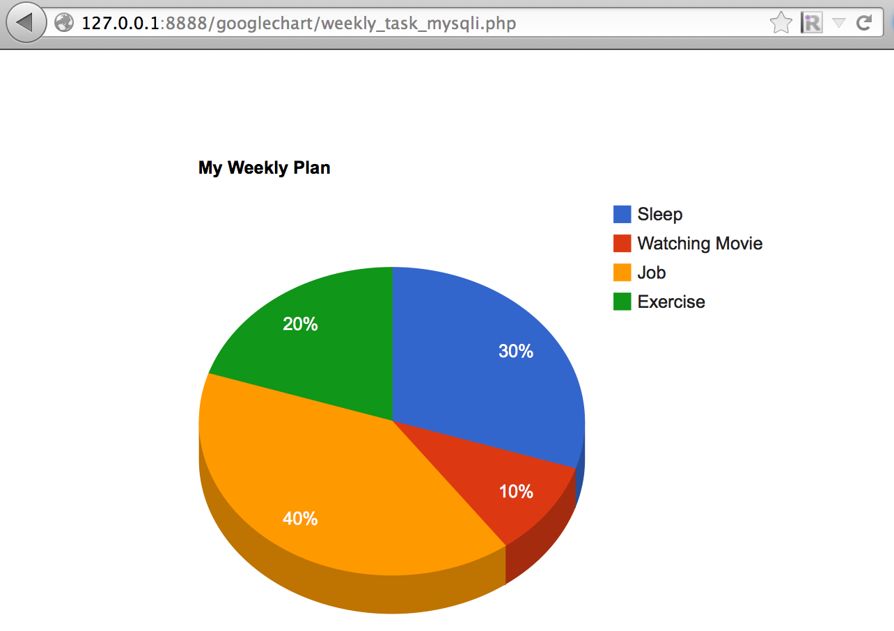
http://stackoverflow.com/questions/12994282/php-mysql-google-chart-json-complete-example

Slide 50
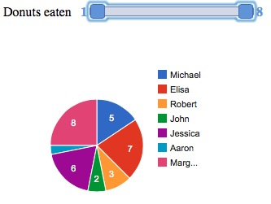
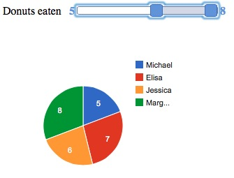
6. Controls and Dashboards
https://developers.google.com/chart/interactive/docs/gallery/controls

Slide 51
Draw a Dashboard
1. Create An HTML Skeleton For Your Dashboard
2. Load Your Libraries
3. Prepare Your Data
4. Create a Dashboard Instance
5. Create Control and Chart Instances
6. Establish Dependencies (=bind)
7. Draw Your Dashboard
8. Programmatic Changes after Draw
google.load('visualization', '1.0',{'packages':['controls']});
….
dashboard.bind(donutRangeSlider, pieChart);
dashboard.draw(data);
https://developers.google.com/chart/interactive/docs/gallery/controls

Slide 52
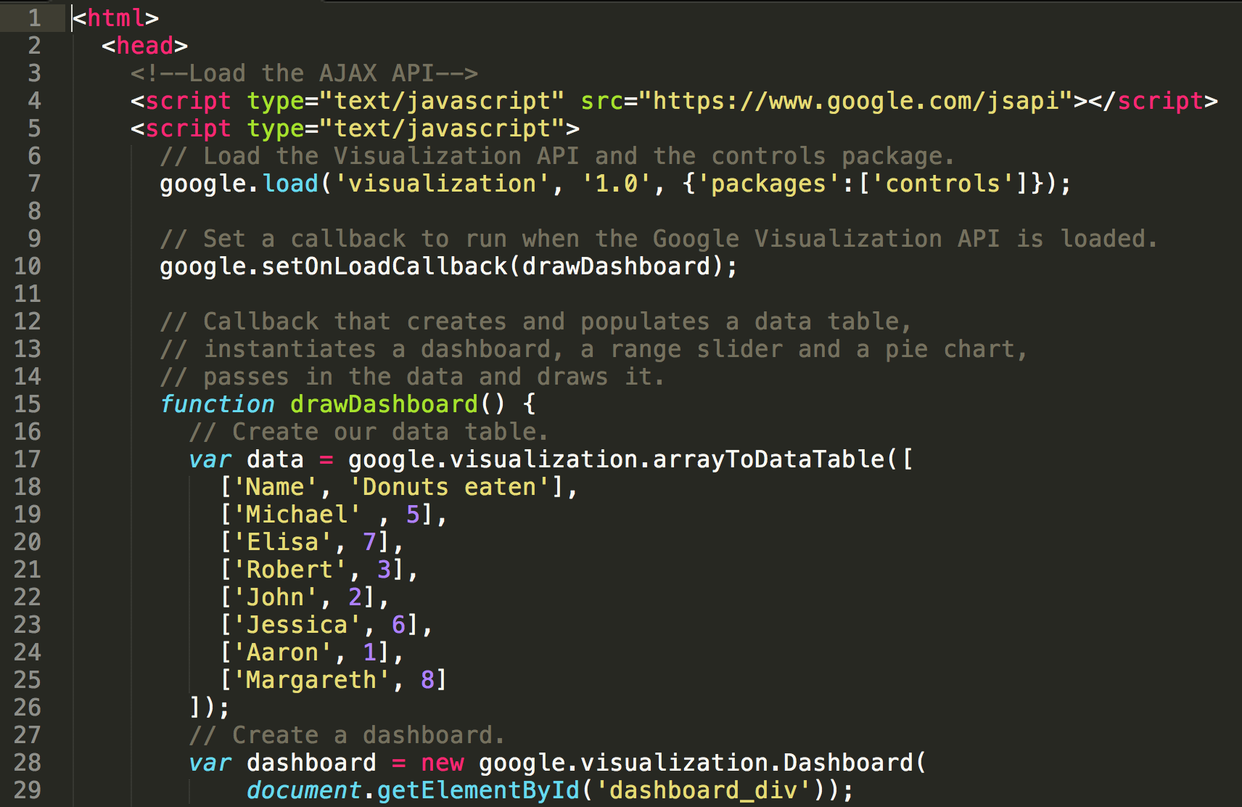
example4_controls.html

Slide 53
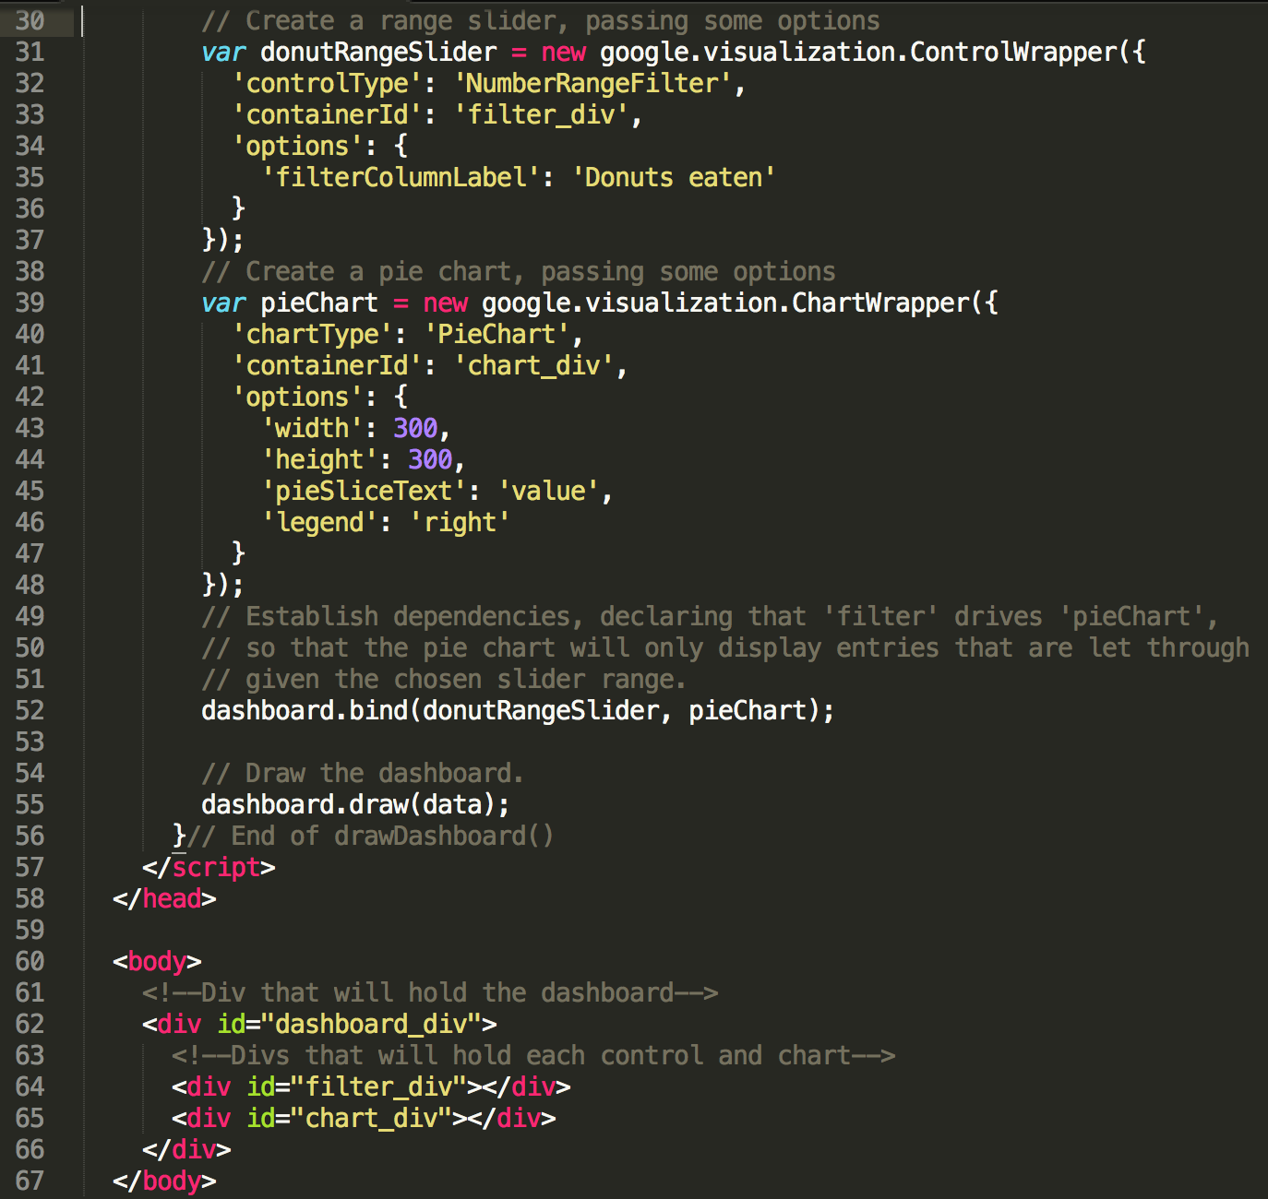

Slide 54
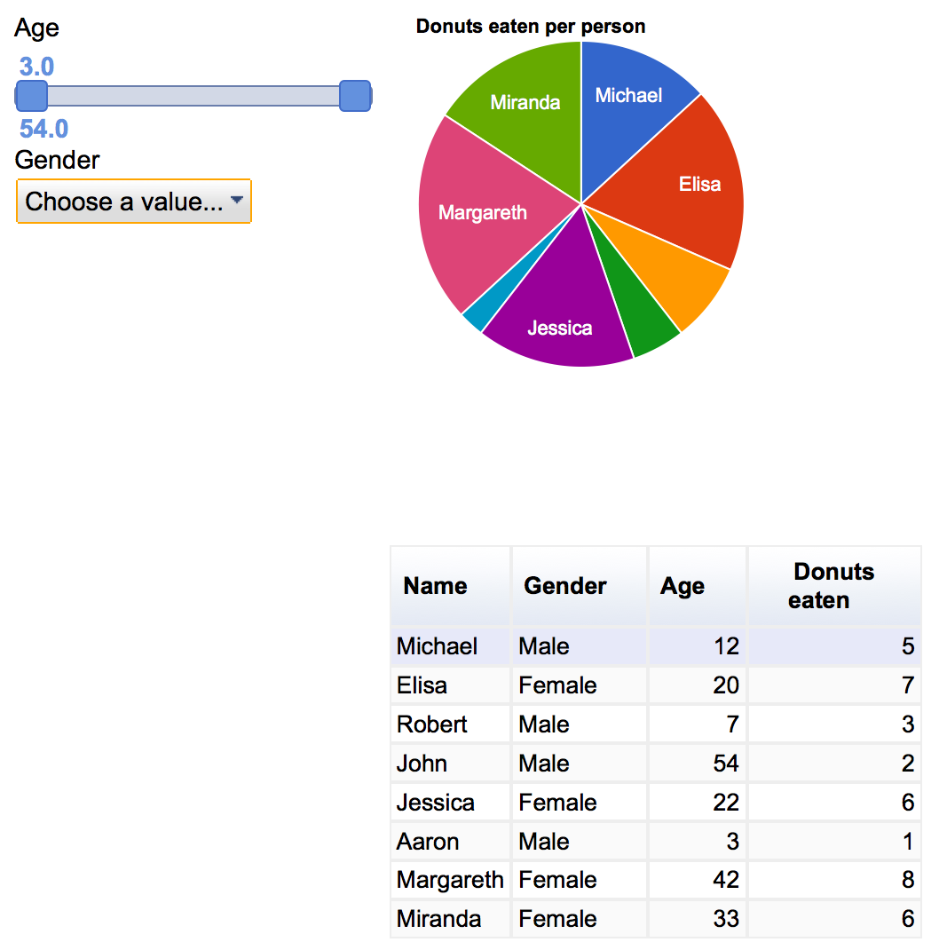
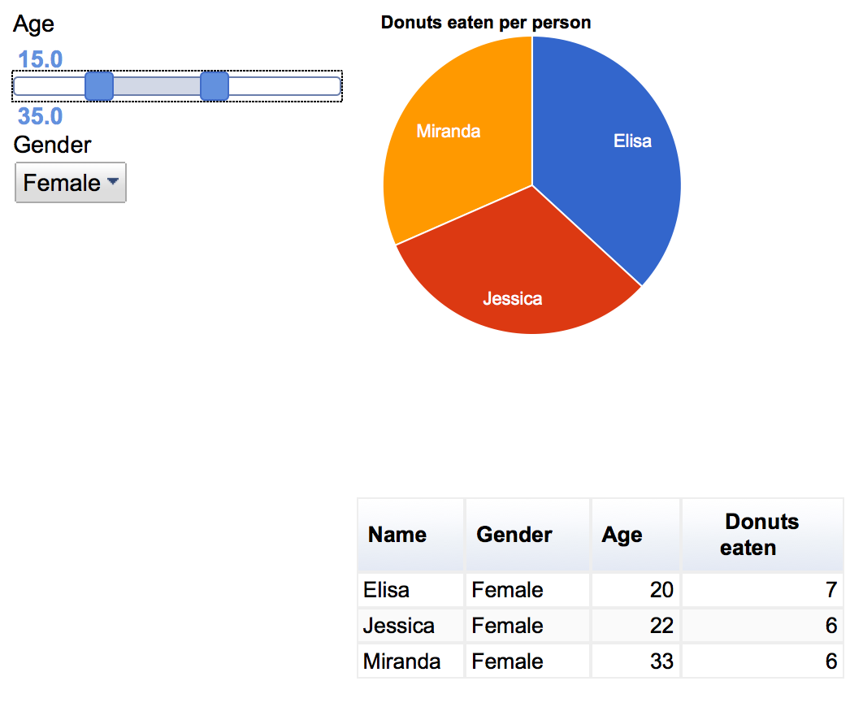
Dashboard with multiple controls and a remote data source
new google.visualization.Dashboard(document.getElementById('dashboard'))
.bind([slider, categoryPicker], [pie, table]).draw(data);

Slide 55
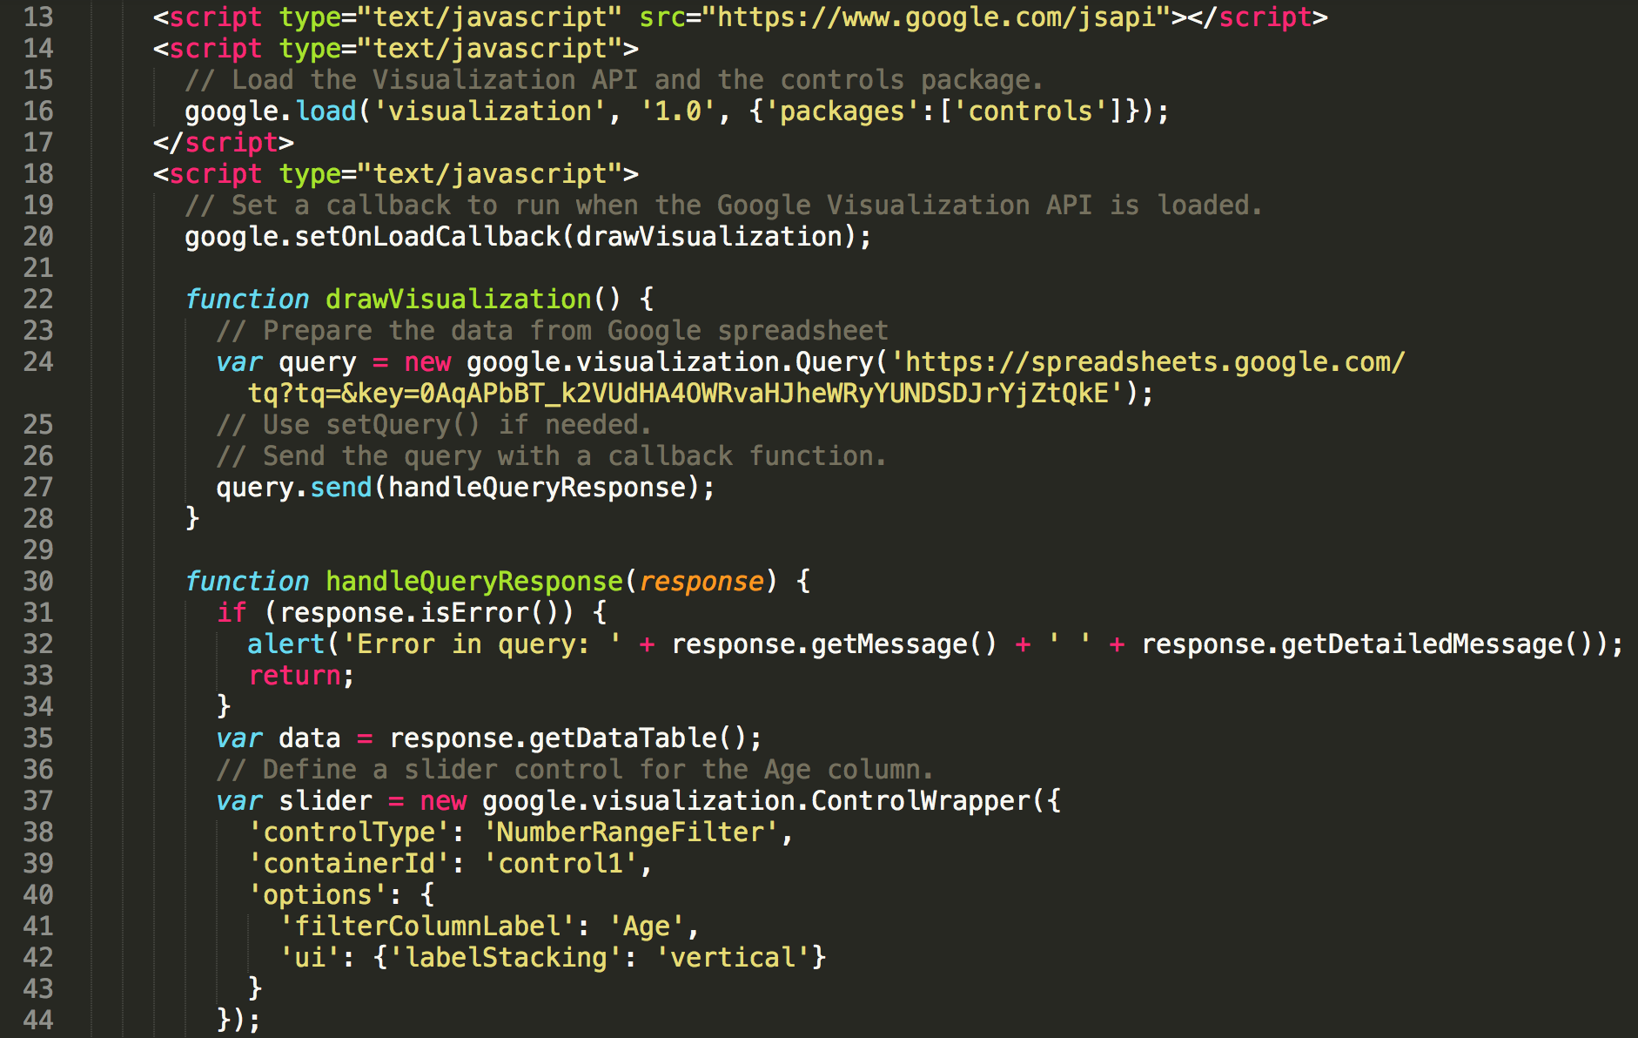
example5_dashboard.html

Slide 56
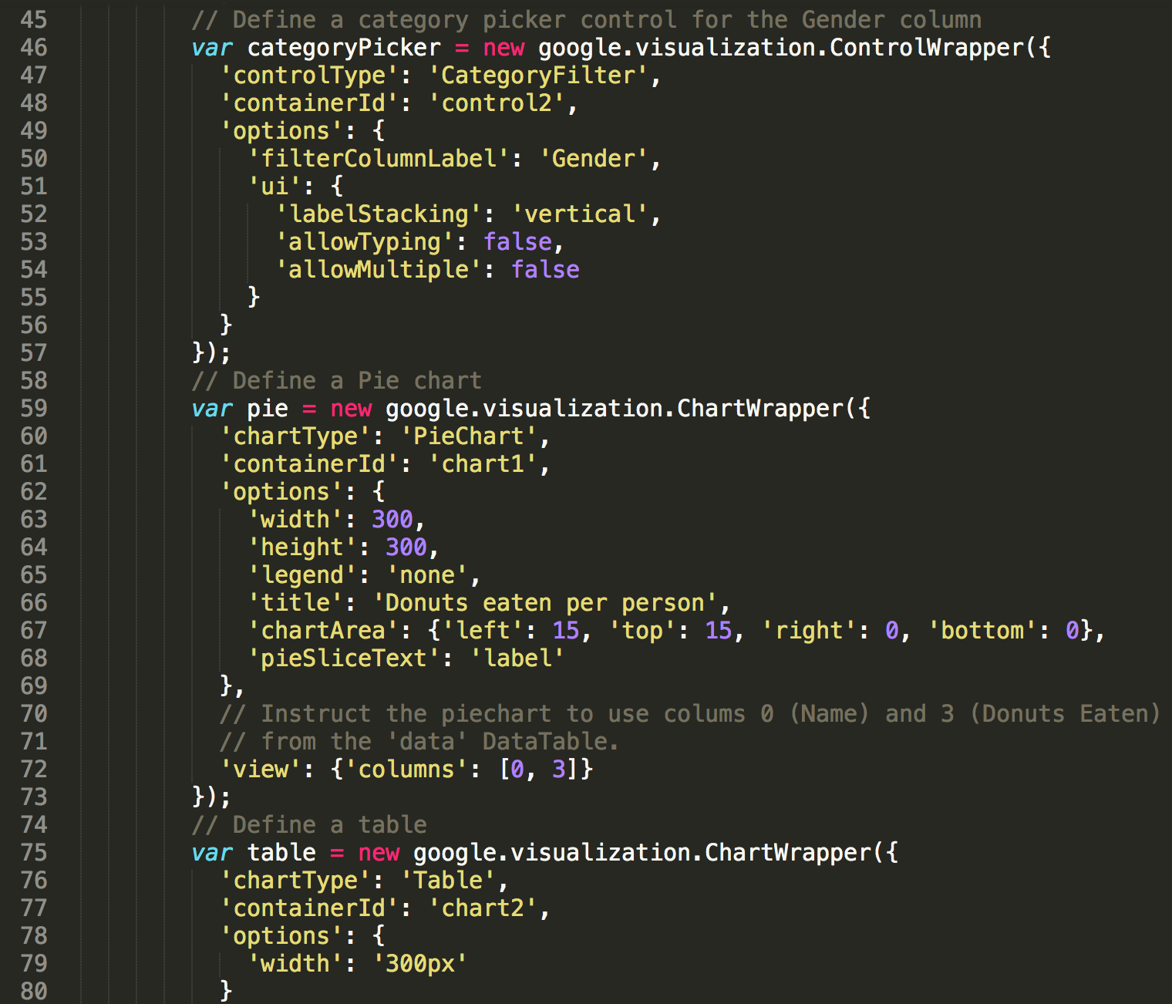

Slide 57
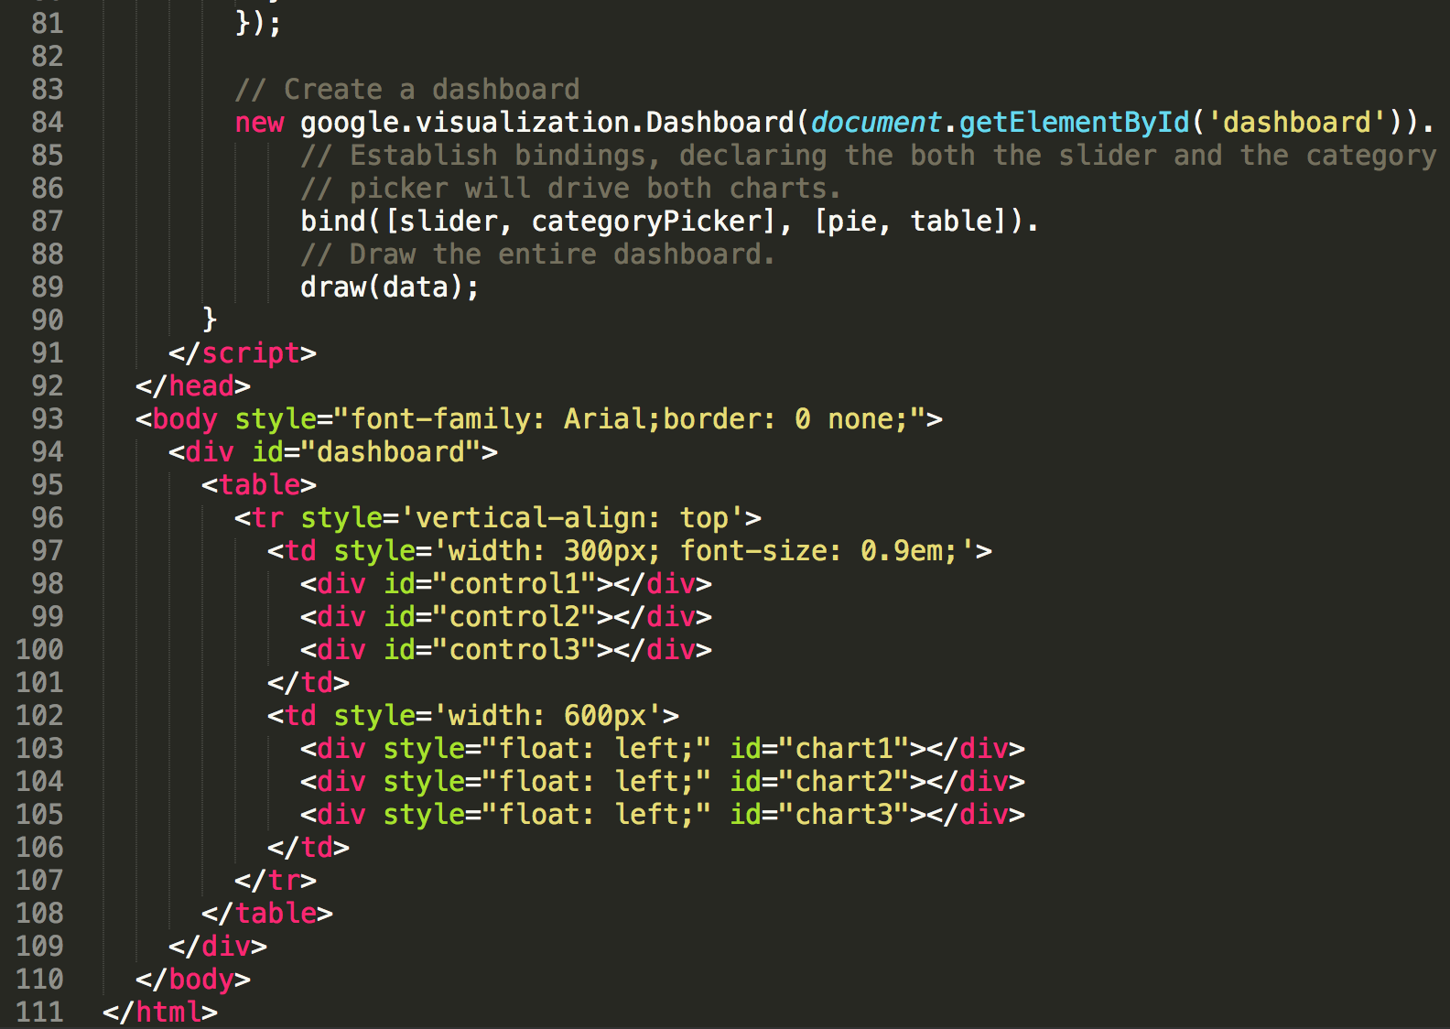

Slide 58
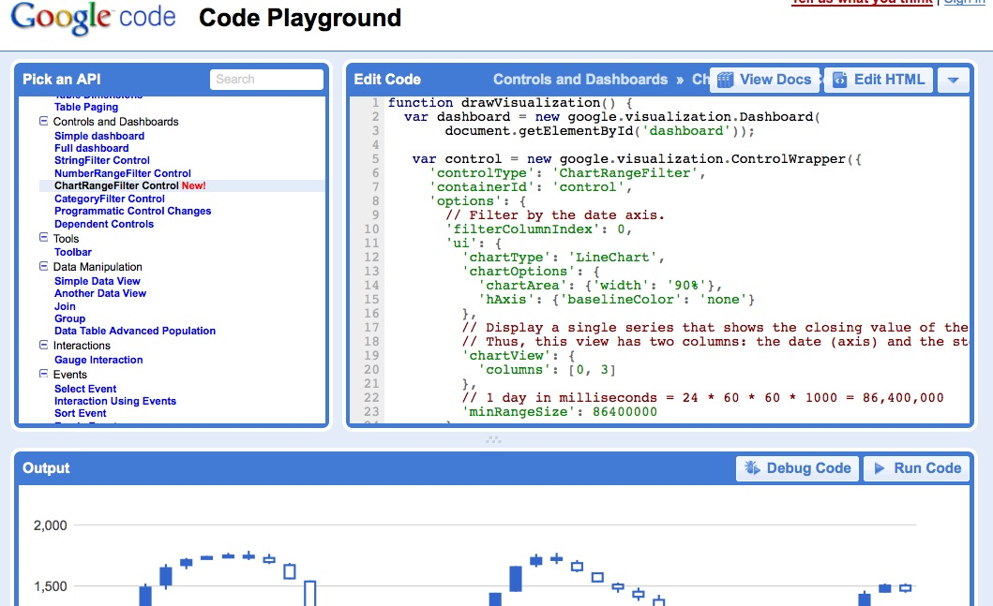
Google Code playground
http://code.google.com/apis/ajax/playground/

Slide 59
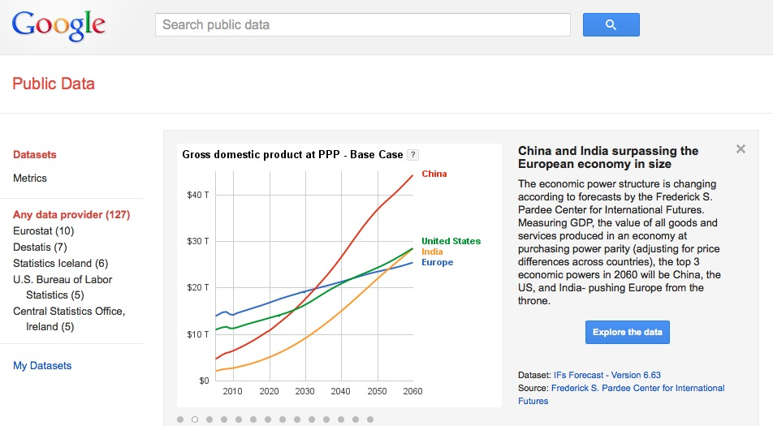
Google Public Data Explorer
http://www.google.com/publicdata/directory

Slide 60
Questions?
Slides: http://slideshare.net/bohyunkim
Code: https://github.com/bohyunkim/examples
Twitter: @bohyunkim
Web: http://bohyunkim.net/blog
Image credit for the title slide: https://www.flickr.com/photos/44718928@N00/7219422352/
by the Flickr user @justgrimes

